Slide 1



IHADLAB
MACHINE LEARNING AND ARTIFICIAL INTELLIGENCE
BITCOIN PRICES PREDICTION
AMIN KOMEILI

Slide 2

IHADLAB
PROBLEM STATEMENT
Bitcoin prices rise and fall fast, making it tough for anyone to know what will happen next.
This project focuses on building a model that learns from old price data and gives a helpful guess about future prices.

Slide 3




IHADLAB
Two Sigma: Using News to Predict Stock Movements
Sep 2018 Aug 2019
A ndrew Lukyanenko

Slide 4
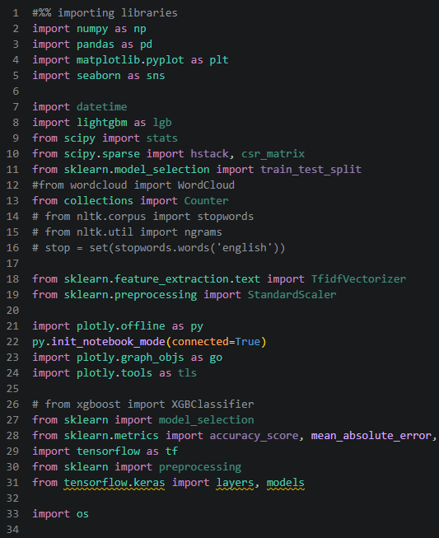
IHADLAB
LIBRARIES

Slide 5
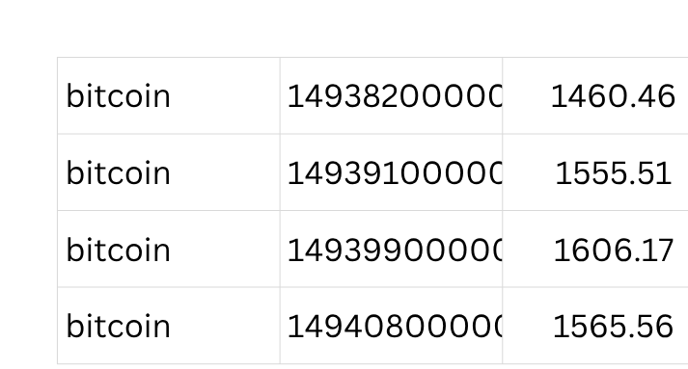
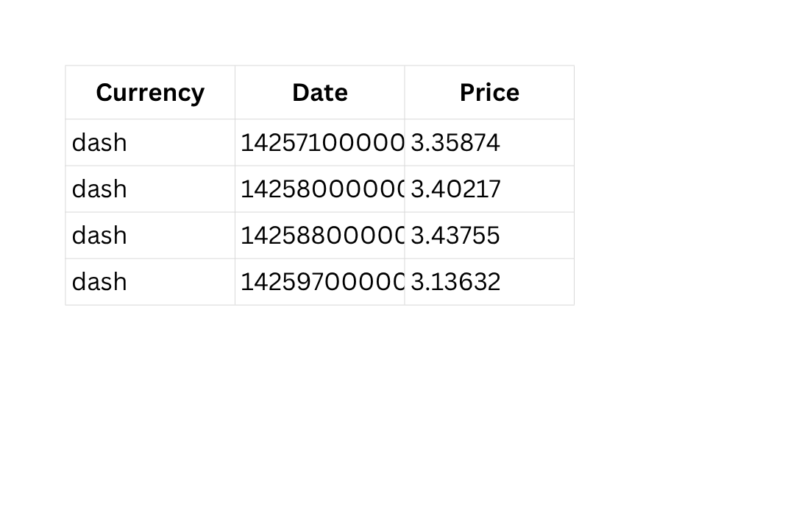
IHADLAB
DATA DESCRIPTION
currency #1515
#1733
data size #657317
Jul.2013 Feb. 2018

Slide 6
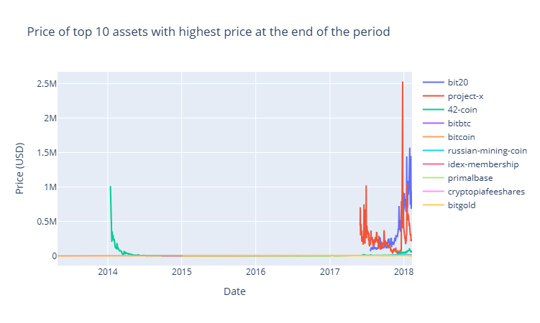
IHADLAB
DATA PREPARATION
Currency value > $1M (n=3)
Currency value < $0.01 (n=353)
currency #1515 → 1512
currency #1512 → 1159

Slide 7
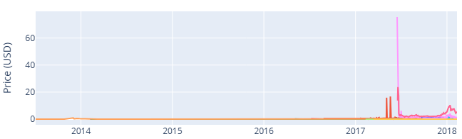
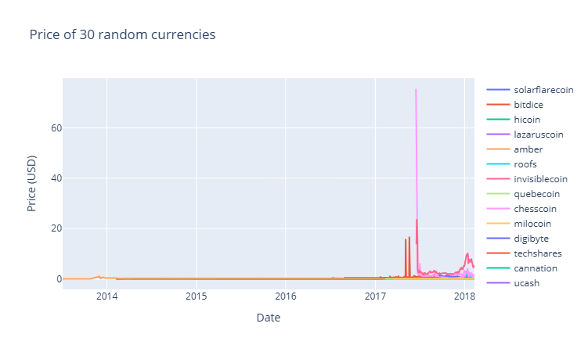
IHADLAB
DATA PREPARATION
Some currencies emerged recently
Analysis period
Jul.2013 Feb. 2018
Jan.2014
Jul.2013 Feb. 2018
currency #1159
currency #55

Slide 8
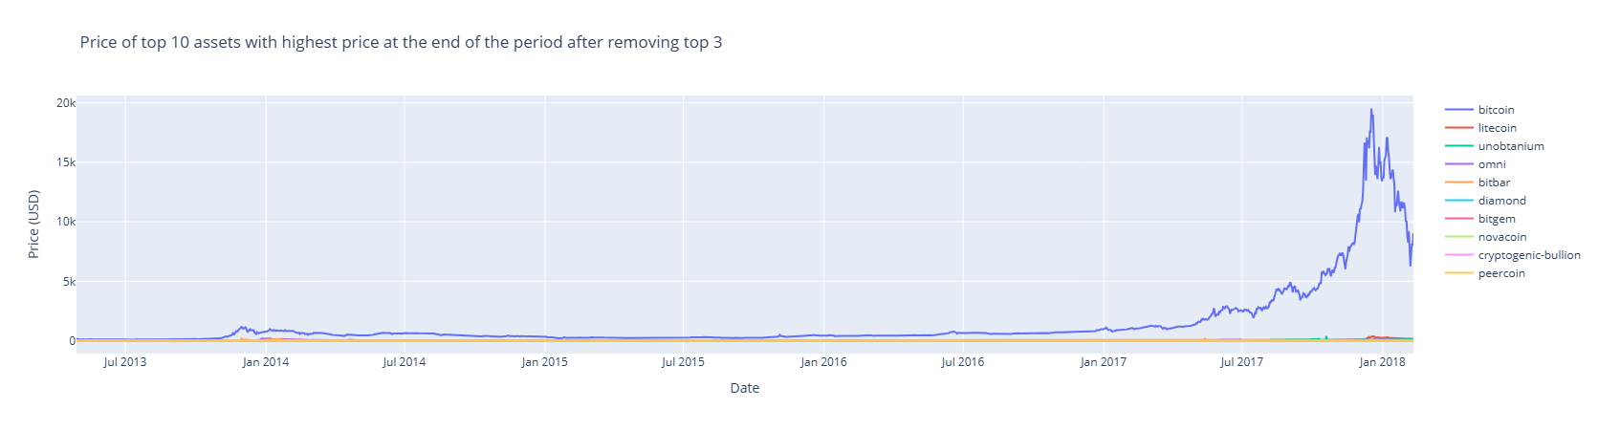
IHADLAB
DATA PREPARATION

Slide 9
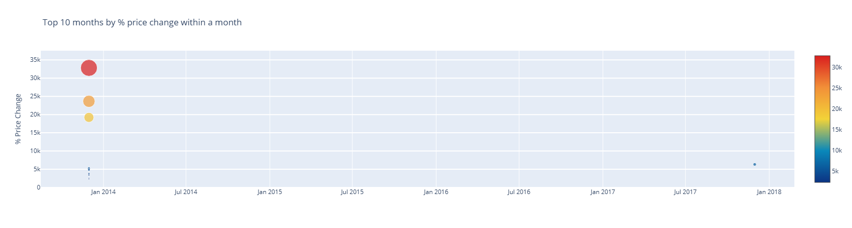
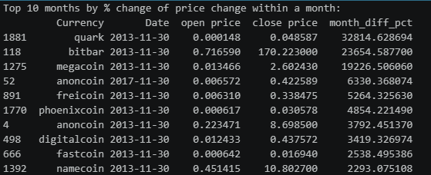
IHADLAB
DATA PREPARATION
Δ monthly price > 2,000%
currency #55 → #45

Slide 10
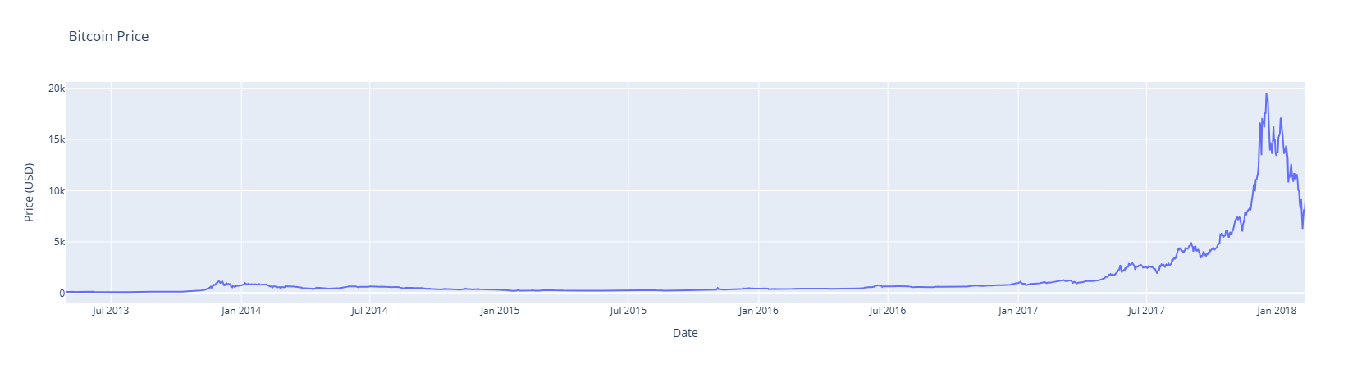
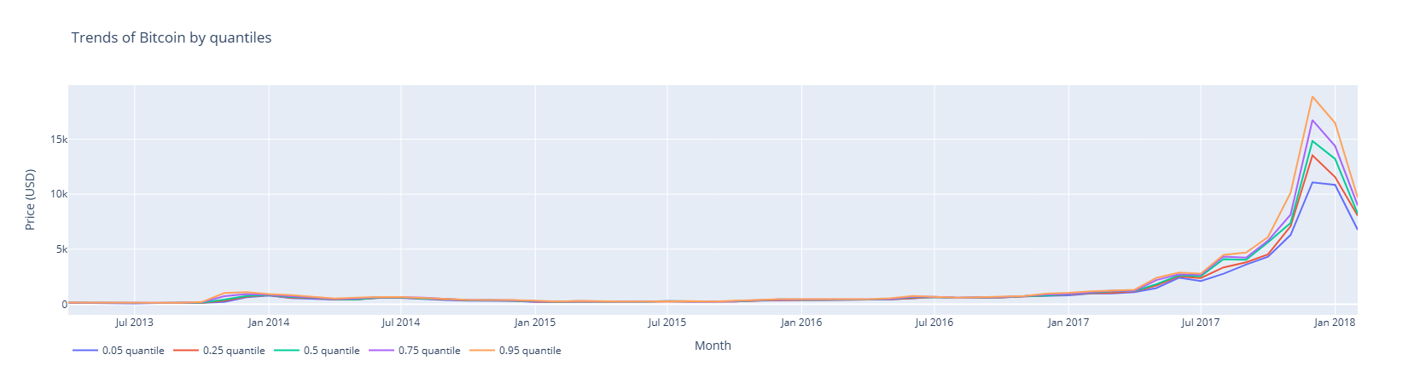
IHADLAB
DATA DESCRIPTION

Slide 11
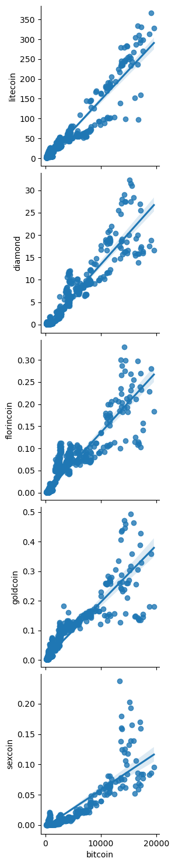


IHADLAB
FEATURE ENGINEERING
Pairwise Regression
R2 =0.92
R2 =0.90
0 10k 20K
0 10k 20K

Slide 12
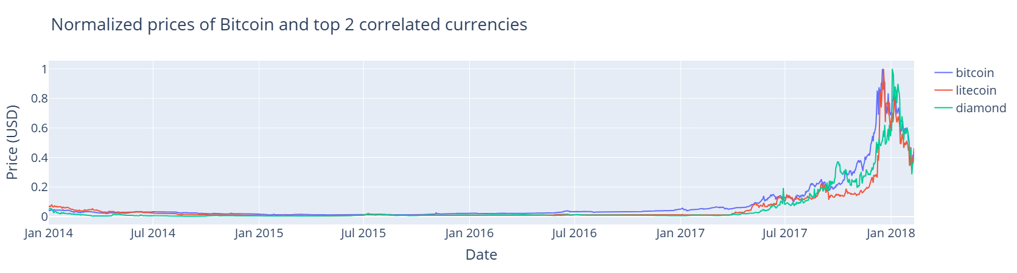
IHADLAB
FEATURE ENGINEERING

Slide 13
IHADLAB
MODELS
01-RNN
02-RNN Optuna
03-RNN
(Many-to-Many)
60 Days
1 Day
History
Pred.
Training
Test
2014 2017 2018

Slide 14
IHADLAB
MODELS
01-RNN
03-RNN
(Many-to-Many)
Features: [bitcoin]
LSTM [input, 32, 16, 1]
batch_size= 5,
epochs= 200,
History = 60
Future Pred= 1
monitor='loss',
early_stopping,
optimizer= adam
loss= MSE
Features: [bitcoin, litecoin ]
LSTM [input, 128]-> repeated → LSTM[128,64,1]
batch_size= 5,
epochs= 200,
History = 60
Future Pred= 5
monitor='loss',
early_stopping,
optimizer=adam
loss= MSE
Total params: 248,129
02-RNN Optuna
(#Trials=50)
n_trials=50
Features: [bitcoin, litecoin, diamond]
LSTM [input, 16-64, 32-128, 1]
dropout = 0.0-0.005
batch_size = 4-8,
learning rate = 1-1000 e-3
epochs= 100,
History = 60
Future= 1
monitor='loss',
early_stopping,
optimizer=adam
loss= MSE
Total params: 22,5177

Slide 15
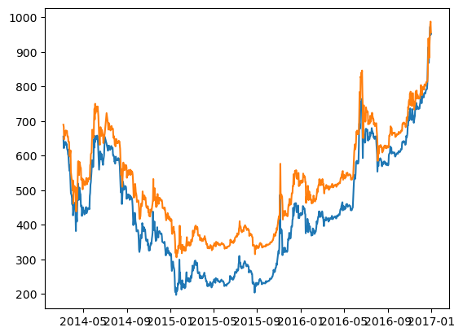
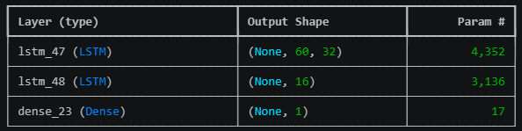
IHADLAB
01-RNN
RESULTS
Pred.
5.0 e-5
22,500
1
Loss
Parameters
Features
Actual
Features: [bitcoin]
LSTM [input, 32, 16, 1]
batch_size= 5,
epochs= 200,
History = 60
Future Pred= 1
monitor='loss',
early_stopping,
2014 2015 2016 2017

Slide 16
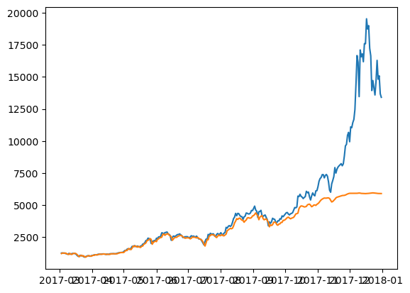
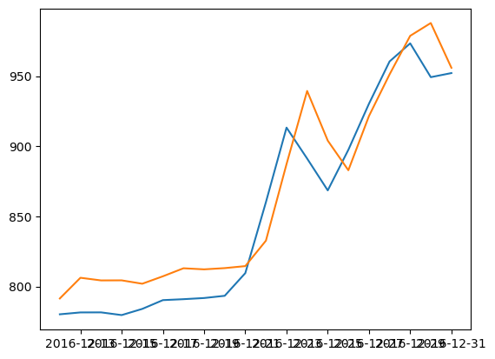
IHADLAB
01-RNN
Train
Test
2014 2017
2017 2018

Slide 17
IHADLAB
02-RNN Optuna
RESULTS
?
22,500
1 , 2, 3
Loss
Parameters
Features
n_trials=50
Features: [bitcoin, litecoin, diamond]
LSTM [input, 16-64, 32-128, 1]
dropout = 0.0-0.005
batch_size = 4-8,
learning rate = 1-1000 e-3
epochs= 100,
History = 60
Future Pred= 1
monitor='loss',
early_stopping,
optimizer=adam
loss= MSE

Slide 18
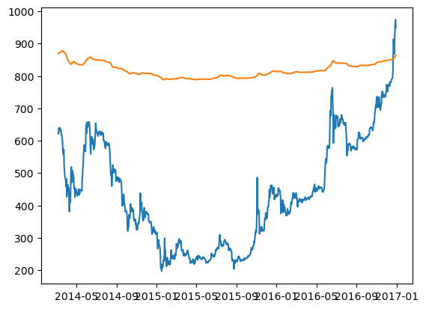
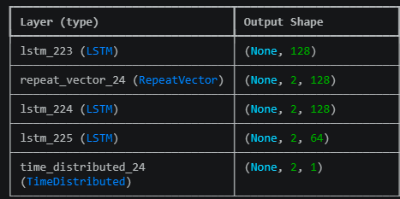
IHADLAB
03-RNN
(Many-to-Many)
RESULTS
Pred.
3.0 e-3
248,000
2
Loss
Parameters
Features
Actual
Features: [bitcoin, litecoin ]
LSTM [input, 128]-> repeated → LSTM[128, 64, 1]
batch_size= 5,
epochs= 30,
History = 60
Future Pred= 5
monitor='loss',
early_stopping,
optimizer=adam
loss= MSE
2014 2015 2016 2017

Slide 19
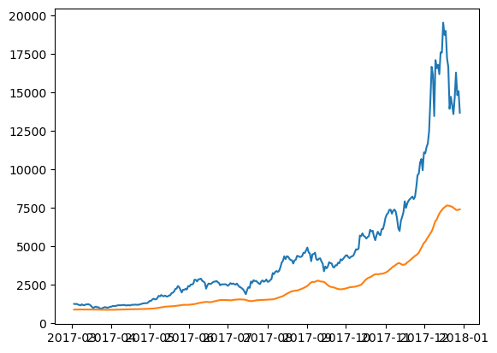
IHADLAB
03-RNN
(Many-to-Many)
Train
Test
2014 2015 2016 2017
2017
2018

Slide 20
Test
IHADLAB
03-RNN
(Many-to-Many)
2017
2018
Train
2014 2015 2016 2017

Slide 21


Test
IHADLAB
03-RNN
(Many-to-Many)
2017
2018
Train
2014 2015 2016 2017

Slide 22



Test
IHADLAB
03-RNN
(Many-to-Many)
2017
2018
Train
2014 2015 2016 2017

Slide 23

Test
IHADLAB
03-RNN
(Many-to-Many)
2017
2018
Train
2014 2015 2016 2017

Slide 24

IHADLAB
Challenges
Data Preparation
Feature Selection
Knowledge Domain
01
04
What are artifacts
Technical:
Changes in the Bitcoin white paper
Network upgrades
Improvements in blockchain efficiency
News:
Regulatory announcements (Taxation policies)
Macroeconomic signals (interest rates)
Market correlations (Stock market indices)
Events (wars, pandemics)
Selecting Best Model
02
Hyperparameters
Data
Performance Evaluation
03
05
Bitcoin price is highly sensitive to exogenous variables, especially news and macro events. Integrating other databases will help.
Conventional metrics:
RMS, MSE,
$R^{2}$
New metrics ?

Slide 25



IHADLAB
TARGET AUDIENCE
Financial & Crypto Traders
Financial Institutions
Risk Management Analysts
Retail traders
Hedge funds
Crypto market makers
Investment firms / asset managers
FinTech platforms
Regulators / policy makers
Risk analysts in firms

Slide 26



IHADLAB
BUSINESS POTENTIAL
Core Value Proposition
This model creates value by:
Reducing decision uncertainty
Converting data → actionable signals
Monetization Pathways
A. Trading-as-a-Service
Use the model internally for algorithmic trading
Revenue = trading profits
B. Signal Subscription Platform
Sell predictions/signals: (Buy / Sell / Hold)
Monthly subscription (e.g., $20–$200/month)
C. Offer the model as an API
Customers: FinTech startups, Trading platforms

Slide 27

COMPETITORS
IHADLAB

Slide 28
IHADLAB
CONCLUSION
Strong Market and Demand
Strong Competitors
Non-conventional evaluation metrics in training

Slide 29

IHADLAB
THANK YOU
WWW.REALLYGREATSITE.COM

